Slide 1
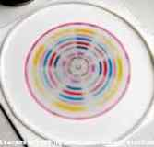
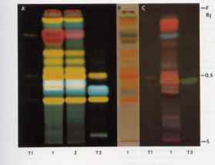
Chromatography

Slide 2
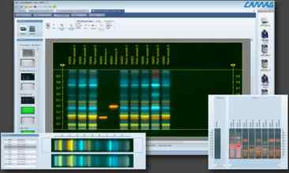
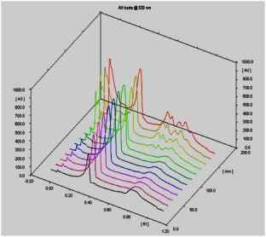
HPTLC Workshop

Slide 3
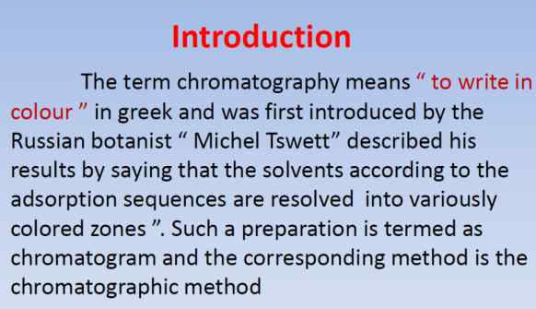

Slide 4
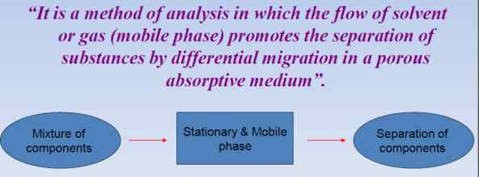

Slide 5
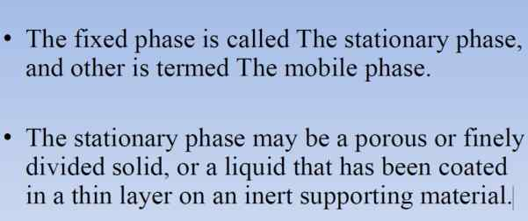

Slide 6
Different Kinds of Chromatography
Liquid chromatography (includes column chromatography, thin-layer, and HPLC)
  Stationary phase: silica, alumina, etc.
  Mobile phase (moving phase): organic solvents
  Important properties: polarity
Gas chromatography
  Stationary phase: a film of a polymer or a wax. The film must have a high boiling point
  Mobile phase: gas (Helium is the usual carrier gas)
  Important properties: boiling point

Slide 7
Liquid Chromatography
Adsorption
Partition
Size Exclusion
Affinity
Ion Exchange
Competition between liquid mobile phase and Liquid stationary phase
Competition between liquid mobile phase and solid stationary phase
Competition between liquid mobile phase and Liquid stationary phase
Molecular
sieveing
Lock and Key Mechanism
Competition between liquid mobile phase and ionic stationary phase

Slide 8
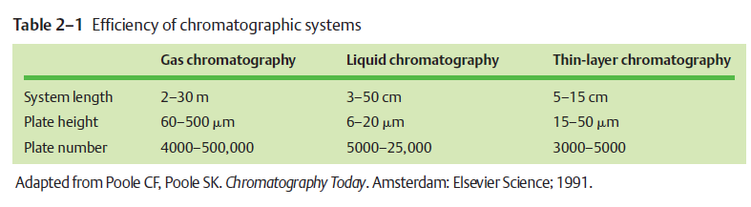

Slide 9
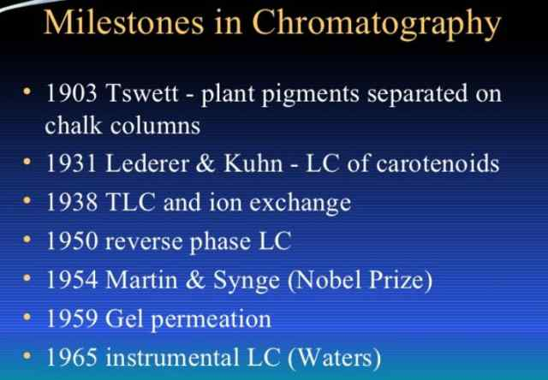

Slide 10
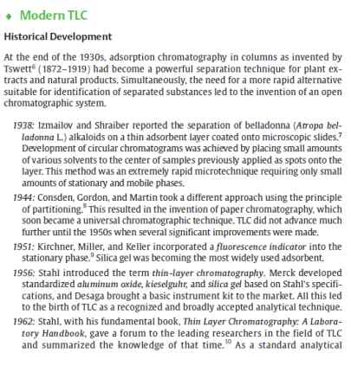
Thin layer Chromatography

Slide 11
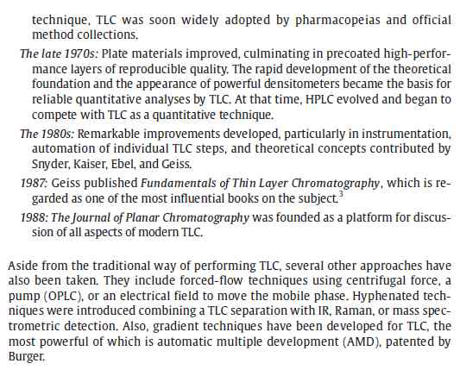

Slide 12
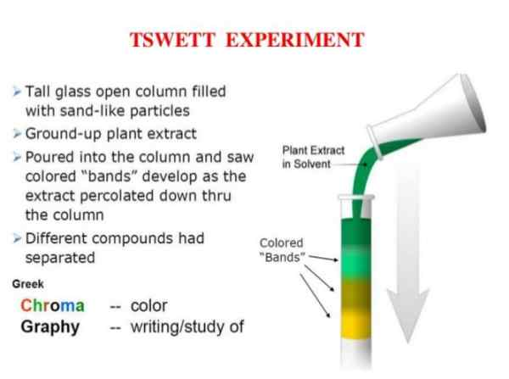

Slide 13
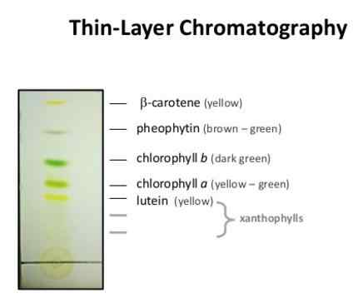

Slide 14
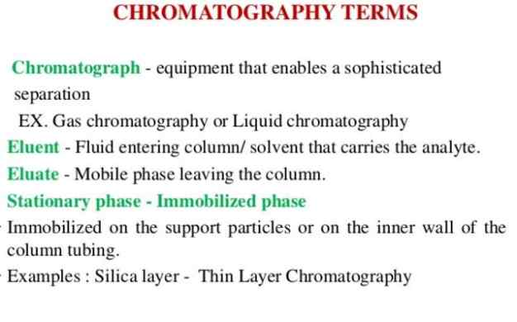

Slide 15
Thin-Layer Chromatography: Determination of R_{f} Values
R_{f} of component A =
d_{A}
d_{S}
R_{f} of component B =
d_{B}
d_{S}
The R_{f} value is a decimal fraction, generally only reported to two decimal places

Slide 16
Thin-Layer Chromatography: Qualitative Analysis

Slide 17
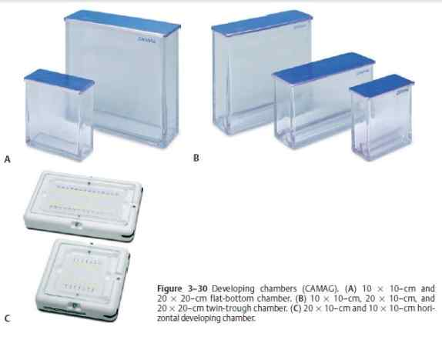

Slide 18
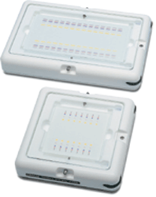
Horizontal Developing Chamber

Slide 19
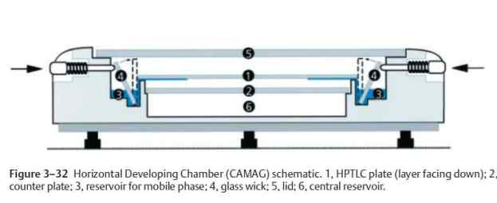

Slide 20
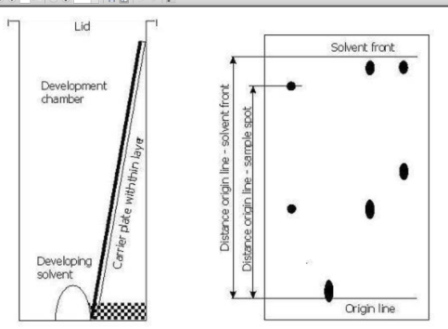

Slide 21
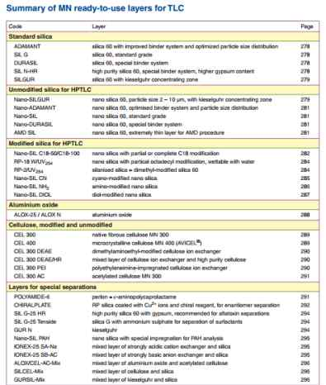

Slide 22
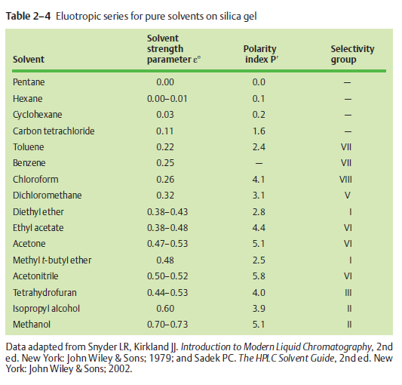

Slide 23
Visualization Method
Vizualization is a method that is used to render the TLC spots visible.
A visualization method can be:
  Ultraviolet light
  Iodine vapors to stain spots
  Colored reagents to stain spots
  Reagents that selectively stain spots while leaving others unaffected.

Slide 24
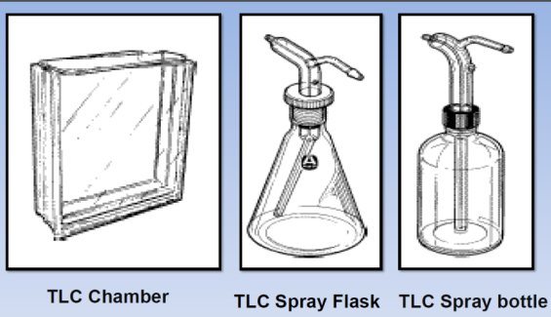

Slide 25
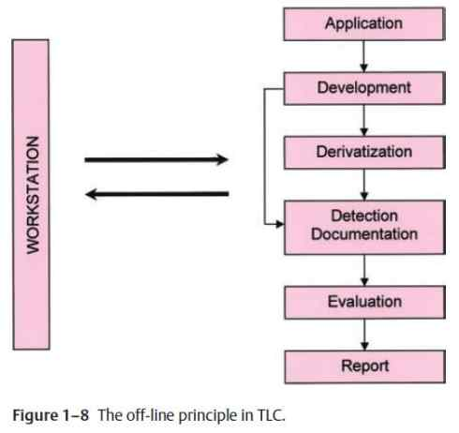

Slide 26
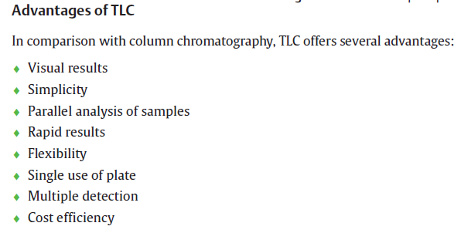

Slide 27
Limitations of TLC
TLC is an open system exposed to the environmental effects like air( oxygen), climatic factors (Temperature, Humidity), Light , Fume, mechanical stress) so sensitive samples needs special care to achieve reproducible results.
Requires Manual action (Although there are computer controlled instuments available for each step but it is not feasible.
It is not suitable for Quantification.
It is not good for Biopolymer.

Slide 28
HPTLC
The State of Art
- Modern equipments(Technology)
- Modern Theoretical foundation(Science)
- Standardized methodology(performance)

Slide 29
This book is not intended to discredit HPLC. ndeed, it is meant for those who use HPLC. An elegant, fast, inexpensive and sufficiently recise preliminary technique for HPLC can now be provided which may be the method of choice for certain analytical problems. The technique has been named HPTLC, high performance thin-layer chromatography

Slide 30
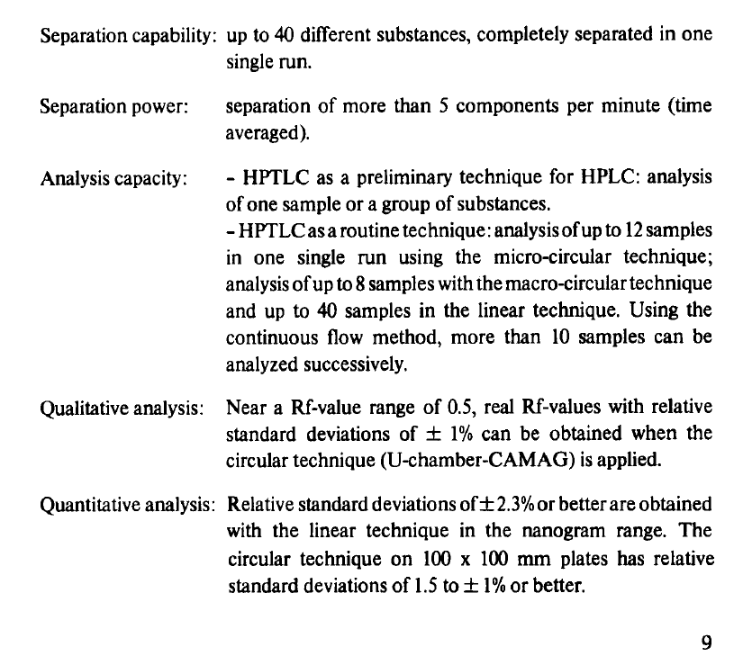

Slide 31
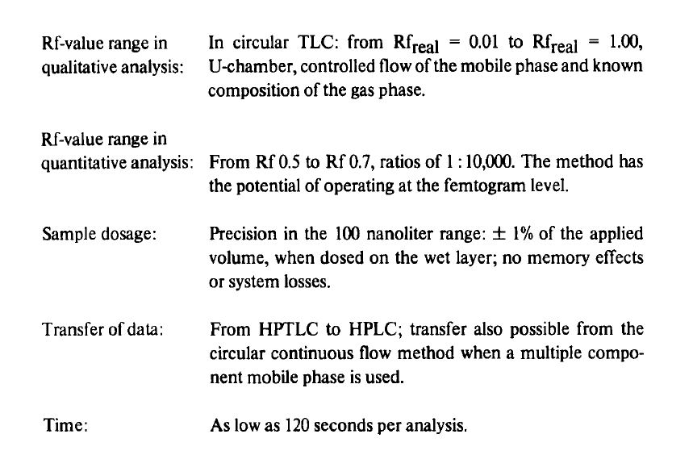

Slide 32
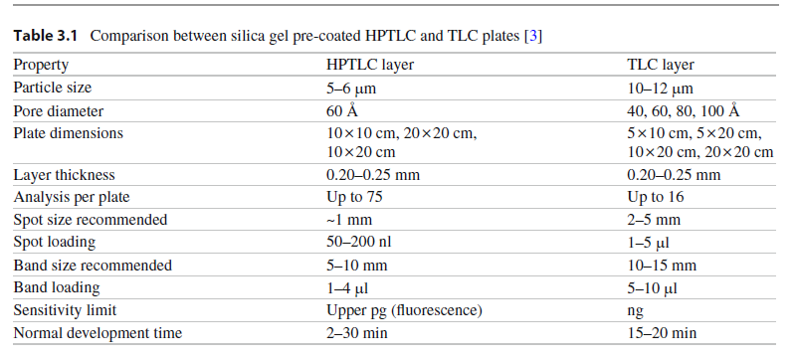

Slide 33
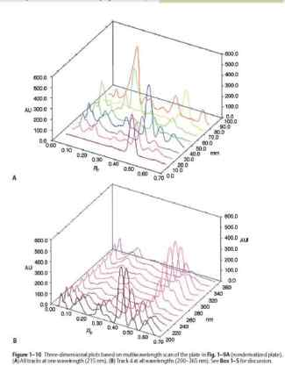
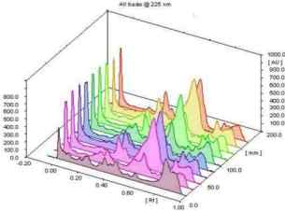

Slide 34
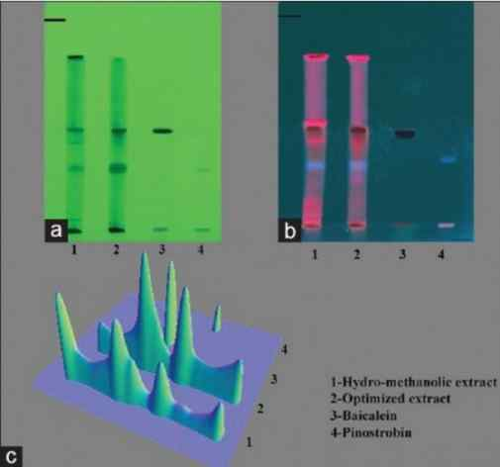

Slide 35
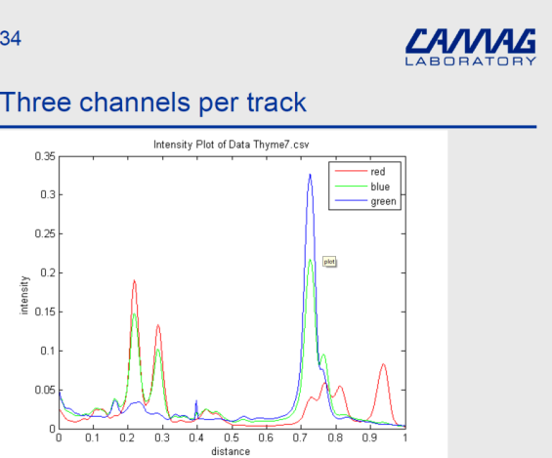

Slide 36
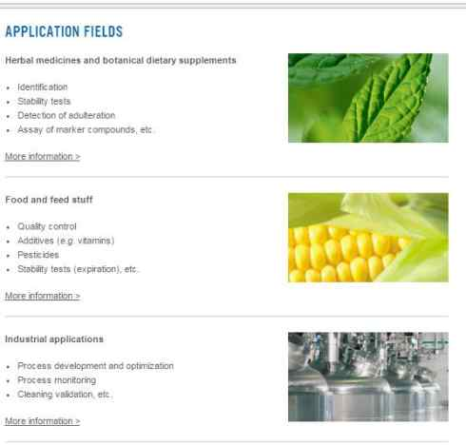

Slide 37
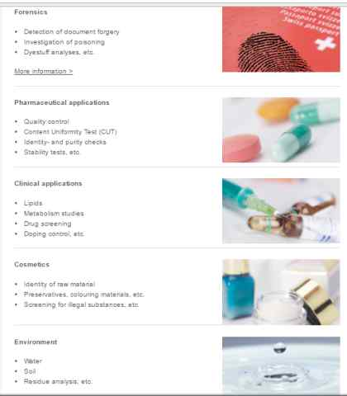

Slide 38
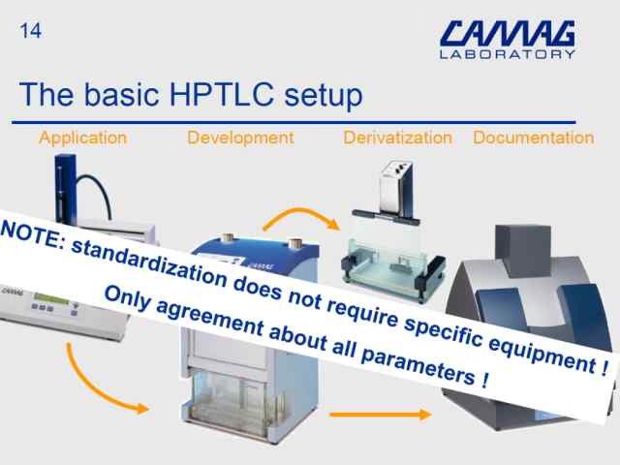

Slide 39
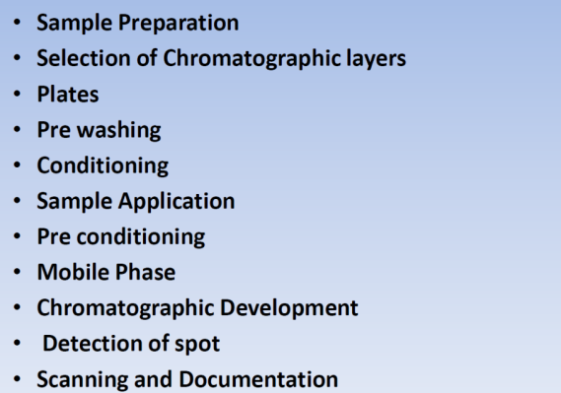
Important steps in HPTLC manual

Slide 40
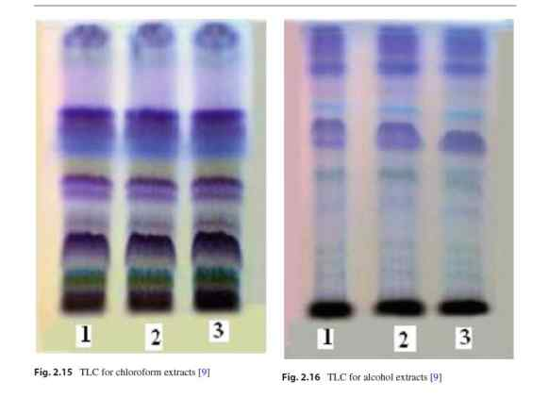

Slide 41
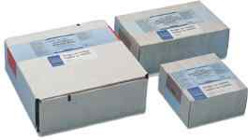
PRECOATED LAYERS

Slide 42
MERCK Precoated layers for HPTLC.
034.5035
HPTLC plates cellulose F
100
10x10
25
034.5036
HPTLC plates cellulose F
100
20x10
50
034.5787
HPTLC plates cellulose (without F)
100
10x10
25
034.5786
HPTLC plates cellulose (without F)
100
20x10
25
034.5631
HPTLC plates silica gel 60 (without F)
200
10x10
25
034.5633
HPTLC plates silica gel 60 (without F)
200
10x10
100
034.5641
HPTLC plates silica gel 60 (without F)
200
20x10
50
034.3748
HPTLC plates silica gel 60 (without F), concentration zone
200
10x10
25
034.3749
HPTLC plates silica gel 60 (without F), concentration zone
200
20x10
50
034.5628
HPTLC plates silica gel 60 F 254
200
10x10
25
034.5629
HPTLC plates silica gel 60 F 254
200
10x10
100
034.5564
HPTLC plates silica gel 60 F 254 GLP
200
10x10
25
034.5642
HPTLC plates silica gel 60 F 254
200
20x10
50
034.1764
HPTLC plates silica gel 60 F 254, extra thin layer
100
20x10
25
034.3727
HPTLC plates silica gel 60 F 254, concentration zone
200
10x10
25
034.3728
HPTLC plates silica gel 60 F 254, concentration zone
200
20x10
50
034.5613
HPTLC plates silica gel 60 F 254 GLP
200
20x10
25
034.1552
HPTLC plates silica gel WR 60 F 254s
200
20x10
25
034.5445
HPTLC plates LiChrospher® Si 60 F 254s
180
20x10
25
034.5547
HPTLC aluminium sheets silica gel 60 (without F)
200
20x20
25

Slide 43
MERCK Precoated Layers for (Conventional) TLC.
034.5713
TLC plates aluminium oxide 60 F 254
250
20x20
25
034.5718
TLC plates cellulose F
100
20x20
25
034.5716
TLC plates cellulose (without F)
100
20x20
25
034.5552
TLC aluminium sheets cellulose (without F)
100
20x20
25
034.5724
TLC plates silica gel (without F)
250
5x20
100
034.5721
TLC plates silica gel (without F)
250
20x20
25
034.1844
TLC plates silica gel (without F), concentration zone
250
10x20
25
034.1845
TLC plates silica gel (without F), concentration zone
250
20x20
25
034.5729
TLC plates silica gel 60 F 254
250
10x20
50
034.5715
TLC plates silica gel 60 F 254
250
20x20
25
034.5566
TLC plates silica gel 60 F 254 GLP
250
20x20
25
034.1846
TLC plates silica gel 60 F 254, concentration zone
250
10x20
50
034.1798
TLC plates silica gel 60 F 254, concentration zone
250
20x20
25
034.5554
TLC aluminium sheets silica gel 60 F 254
200
20x20
25
034.5553
TLC aluminium sheets silica gel 60 (without F)
200
20x20
25
034.5582
TLC aluminium sheets silica gel 60 (without F),
concentration zone
200
20x20
25
034.5583
TLC aluminium sheets silica gel 60, concentration zone
200
20x20
25
034.5735
TLC plastic sheets silica gel 60 F 254
200
20x20
25
034.5748
TLC plastic sheets silica gel 60 (without F)
200
20x20
25
034.5423
TLC plates RP-18 F 254s
250
10x20
50

Slide 44
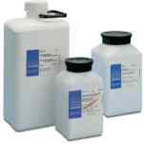
CAMAG Adsorbents.

Slide 45
032.3301
Aluminium Oxide CAMAG DS-0
1 kg
032.3305
Aluminium Oxide CAMAG DS-0
5 kg
032.3351
Aluminium Oxide CAMAG DS-5
1 kg
032.3355
Aluminium Oxide CAMAG DS-5
5 kg
032.3401
Aluminium Oxide CAMAG DSF-0
1 kg
032.3405
Aluminium Oxide CAMAG DSF-0
5 kg
032.3451
Aluminium Oxide CAMAG DSF-5
1 kg
032.3455
Aluminium Oxide CAMAG DSF-5
5 kg
032.3502
Cellulose, fibre type, CAMAG D-0
500 g
032.3512
Cellulose, fibre type, CAMAG DF-0
500 g
032.3552
Cellulose, microcrystalline, CAMAG DS-0
500 g
032.3562
Cellulose, microcrystalline, CAMAG DFS-0
500 g
032.1001
Silica Gel, CAMAG DS-0
1 kg
032.1005
Silica Gel, CAMAG DS-0
5 kg
032.1051
Silica Gel, CAMAG DS-5
1 kg
032.1055
Silica Gel, CAMAG DS-5
5 kg
032.1101
Silica Gel, CAMAG DSF-0
1 kg
032.1105
Silica Gel, CAMAG DSF-0
5 kg
032.1151
Silica Gel, CAMAG DSF-5
1 kg
032.1155
Silica Gel, CAMAG DSF-5

Slide 46
MERCK Adsorbents
033.1090
Aluminium Oxide MERCK G (type 60/E)
500 g
033.1092
Aluminium Oxide MERCK GF (type 60/E)
500 g
033.1091
Aluminium Oxide MERCK G (type 60/E)
2,5 kg
033.1085
Aluminium Oxide MERCK H basic (type 60/E)
500 g
033.1094
Aluminium Oxide MERCK HF basic (type 60/E)
500 g
033.7731
Silica Gel MERCK G (type 60)
1 kg
033.7733
Silica Gel MERCK G (type 60)
5 kg
033.7730
Silica Gel MERCK GF (type 60)
1 kg
033.7729
Silica Gel MERCK GF (type 60)
5 kg
033.7736
Silica Gel MERCK H (type 60)
1 kg
033.7738
Silica Gel MERCK H (type 60)
2,5 kg
033.7745
Silica Gel MERCK HF (type 60)
500 g
033.7739
Silica Gel MERCK HF (type 60)
1 kg
033.7741
Silica Gel MERCK HF 254 + 366 (type 60)
1 kg
033.7744
Silica Gel MERCK 60 HR "high purity"
500 g
033.8129
Kieselguhr MERCK 60 G
500 g

Slide 47
Automatic TLC Plate Coater

Slide 48
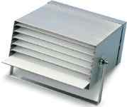
TLC Plate Box.

Slide 49
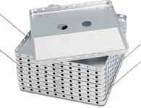
Drying rack

Slide 50
Spot Application
Nanomat
Linomat
Automatic TLC Sampler

Slide 51
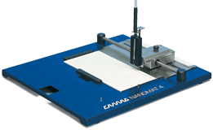
NANOMAT

Slide 52
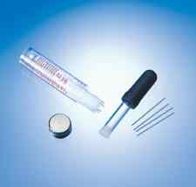
Disposable Glass Capillaries

Slide 53
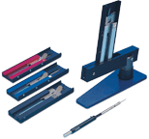
Capillary Dispenser System

Slide 54
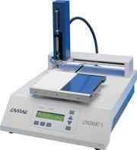
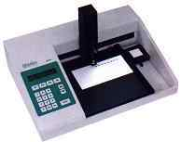
LINOMAT 1V

Slide 55
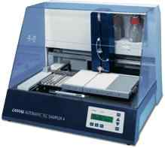
AUTOMATIC TLC SAMPLER

Slide 56
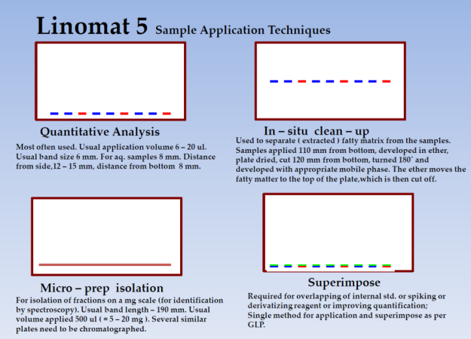

Slide 57
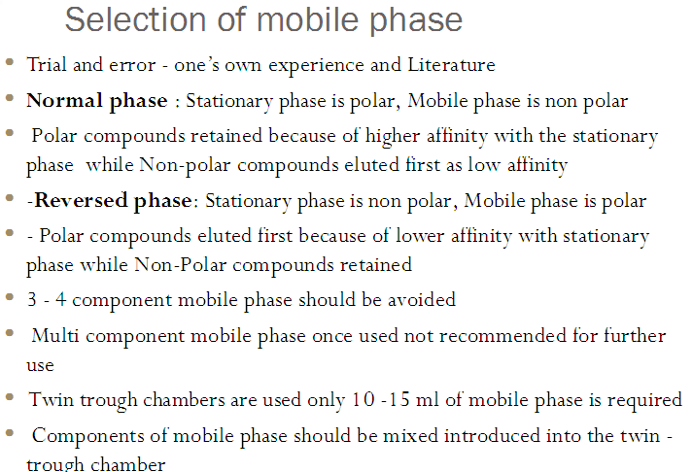
SELECTION OF MOBILE PHASE

Slide 58
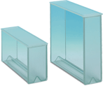
LIGHT WEIGHT TWIN TROUGH CHAMBER

Slide 59
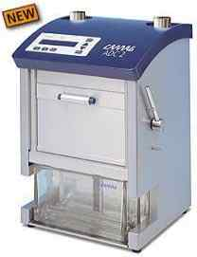
Automatic Developing Chamber ADC

Slide 60
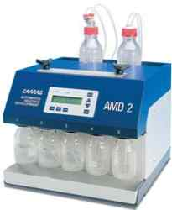
AMD System

Slide 61
DENSITOMETRIC CHROMATOGRAM EVALUATION

Slide 62

TLC Scanner 3 with “CATS” Soft Ware.

Slide 63


UV –INSPECTION -UV Lamps.

Slide 64
POST CHROMATOGRAPHIC DERIVATIZATION
General.
Chromatogram Immersion Device.
TLC Sprayer.
Reagent Spray.
TLC Spray Cabinet.
TLC Plate Heater

Slide 65

Chromatogram Immersion Device.

Slide 66

TLC Sprayer.

Slide 67

Reagent Spray.

Slide 68

TLC Spray Cabinet.

Slide 69

TLC Plate Heater

Slide 70
Detection system
Some instrumental Techniques such as
    Densitometry
    Photodiode array detector
    Fluorescence
    FT-IR in ATR Mode
    Mass Spectrometric

Slide 71


Slide 72
Test Dye Mixtures
032.8001
Test Dye Mixture I 100 mL (suitable for silica gel)
Dimethyl yellow - Oracet blue 2R - Oracet red G; solvent: toluene
032.8002
Test Dye Mixture II 100 mL (suitable for silica gel and aluminium oxide)
Sudan black - Artisil blue - Sudan yellow - fatty orange - fat red 7B - (Sudan black separates into two fractions); solvent: toluene
032.8003
Test Dye Mixture III 10 mL (suitable for HPTLC silica gel)
Ciba F II - Indophenol - Ariabel red - Sudan blue II - Sudan IV - dimethylaminoazobenzene; solvent: toluene
032.8004

Slide 73


Slide 74


Slide 75


Slide 76


Slide 77


Slide 78



Slide 79


Slide 80


Slide 81


Slide 82


Slide 83


Slide 84


Slide 85


Slide 86


Slide 87


Slide 88


Slide 89


Slide 90


Slide 91


Slide 92


Slide 93


Slide 94


Slide 95


Slide 96


Slide 97


Slide 98


Slide 99


Slide 100
HPTLC Advantages that must be reemphesised
Short Analysis time( severeal samples side to side( specially important in screening)
Fingerprints!!!
  (although other fingerprints also help)
Lower resolution than HPLC will not show natural variability ,will not confuse us in analysis
Multiple derivatization
Not only peak report but also image report.

Slide 101

Major Indications in Botanicals

Slide 102


Slide 103


Slide 104


Slide 105


Slide 106


Slide 107


Slide 108


Slide 109


Slide 110


Slide 111


Slide 112


Slide 113


Slide 114

Examples of Using HPTLC In Quality control of Botanicals

Slide 115


Slide 116


Slide 117


Slide 118


Slide 119

Bioautography

Slide 120


Slide 121


Slide 122


Slide 123


Slide 124


Slide 125


Slide 126


Slide 127


Slide 128


Slide 129


Slide 130


Slide 131


Slide 132


Slide 133
DIFFERENCES BETWEEN
TLC AND HPTLC

Slide 134
PARAMETER | TLC | HPTLC
Type of chromatographic plates | Hand made/pre coated | Pre coated
Absorbant layer | 200-250mm | 100-150mm
Particle size | 5-20 micrometer | 4-8 micrometer
Application of sample | Manual/semi automatic | Semi automatic
Shape of sample | spot | band

Slide 135
Spot size | 3-6mm | 1-2mm
Sample volume | 1-10 microlit | 0.1-2microlit
No of sample per plate | 15-20 | 40-45
Optimal development distance | 10-15cm | 5-7cm
Development time | Depend upon mobile phase | 40% less than TLC
Quantization | Manual | Manual/ instrumentation
Reproducibility of result | difficult | Reproducible

Slide 137

Reprostar.

Slide 138

Video store.

Slide 139

OPTIMIZATION OF DEVELOPING CONDITION.
HPTLC VARIO SYSTEM.

